Slide 1
For Live Session: A Solution
Unit 10

Slide 2
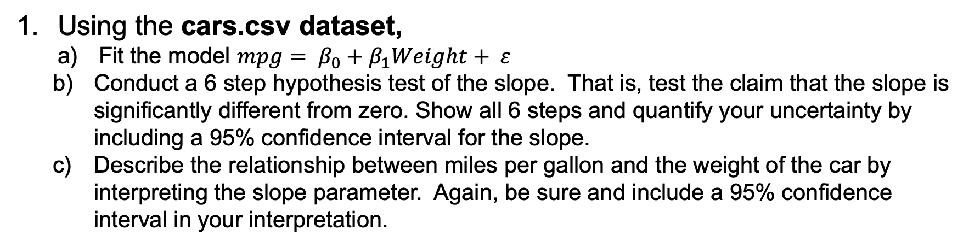
For Live Session: Question 1
Using the cars.csv dataset,
Fit the model $mpg= β_{0}+β_{1}Weight+ ε$
Conduct a 6 step hypothesis test of the slope. That is, test the claim that the slope is significantly different from zero. Show all 6 steps and quantify your uncertainty by including a 95% confidence interval for the slope.
Describe the relationship between miles per gallon and the weight of the car by interpreting the slope parameter. Again, be sure and include a 95% confidence interval in your interpretation.

Slide 3
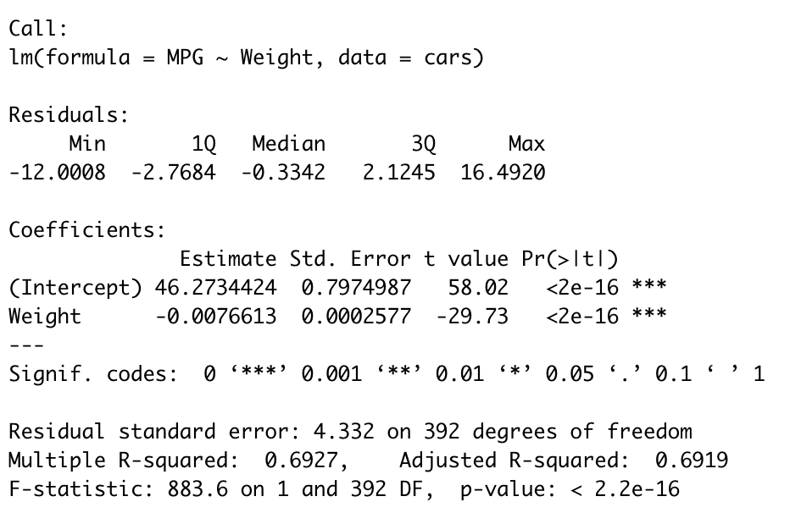
For Live Session: Question 1
Using the cars.csv dataset,
Fit the model $mpg= β_{0}+β_{1}Weight+ ε$
# Use lm to create a linear regression model
fit <- lm(MPG~Weight, data=cars)
# Scatter plot with LR model overlay
cars %>% ggplot(aes(x=Weight, y=MPG)) + geom_point() + ggtitle("LR Model: Weight vs MPG") + geom_smooth(method = "lm")
summary(fit)

Slide 4
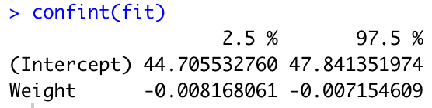
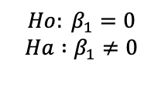
For Live Session: Question 1
Using the cars.csv dataset,
Conduct a 6 step hypothesis test of the slope. That is, test the claim that the slope is significantly different from zero. Show all 6 steps and quantify your uncertainty by including a 95% confidence interval for the slope.
Describe the relationship between miles per gallon and the weight of the car by interpreting the slope parameter. Again, be sure and include a 95% confidence interval in your interpretation.
Step 1 – Ho and Ha
Step 2 – Critical Value (df = 392)
Step 3 – Test Statistic
$$Ho: β_{1}=0$$
$$Ha :β_{1}≠0$$
T-value : -29.73
Step 4 – p-value
Step 5 – Decision
p-value < 2e-16
Reject Ho
Step 6 – Conclusion
There is overwhelming evidence to suggest that slope of the model is not equal to zero (p-value < 0.05,two sided t-test,alpha-0.05).
For every 1 lbs added to the car, the mean miles per gallon are estimated to decrease by 0.007663 mpg. We are 95% confident that this decrease is between -0.0082 and -0.0072. For every 1000 lbs added to the car, the mean miles per gallon are estimated to decrease by 7.663 mpg. We are 95% confident that this decrease is between 7.22 and 8.2 mpg.

Slide 5
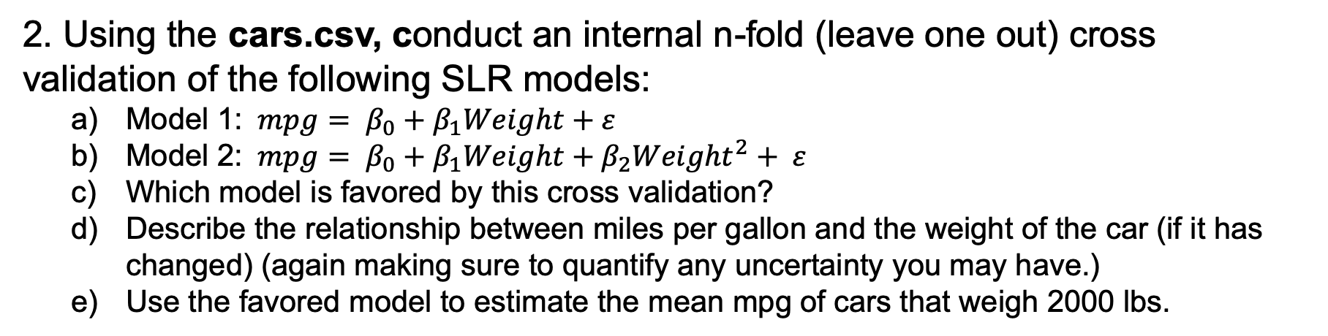
For Live Session: Question 2
2. Using the cars.csv, conduct an internal n-fold (leave one out) cross validation of the following SLR models:
Model 1: $mpg= β_{0}+β_{1}Weight+ε$
Model 2: $mpg= β_{0}+β_{1}Weight+β_{2}{Weight}^{2}+ ε$
Which model is favored by this cross validation?
Describe the relationship between miles per gallon and the weight of the car (if it has changed) (again making sure to quantify any uncertainty you may have.)
Use the favored model to estimate the mean mpg of cars that weigh 2000 lbs.

Slide 6
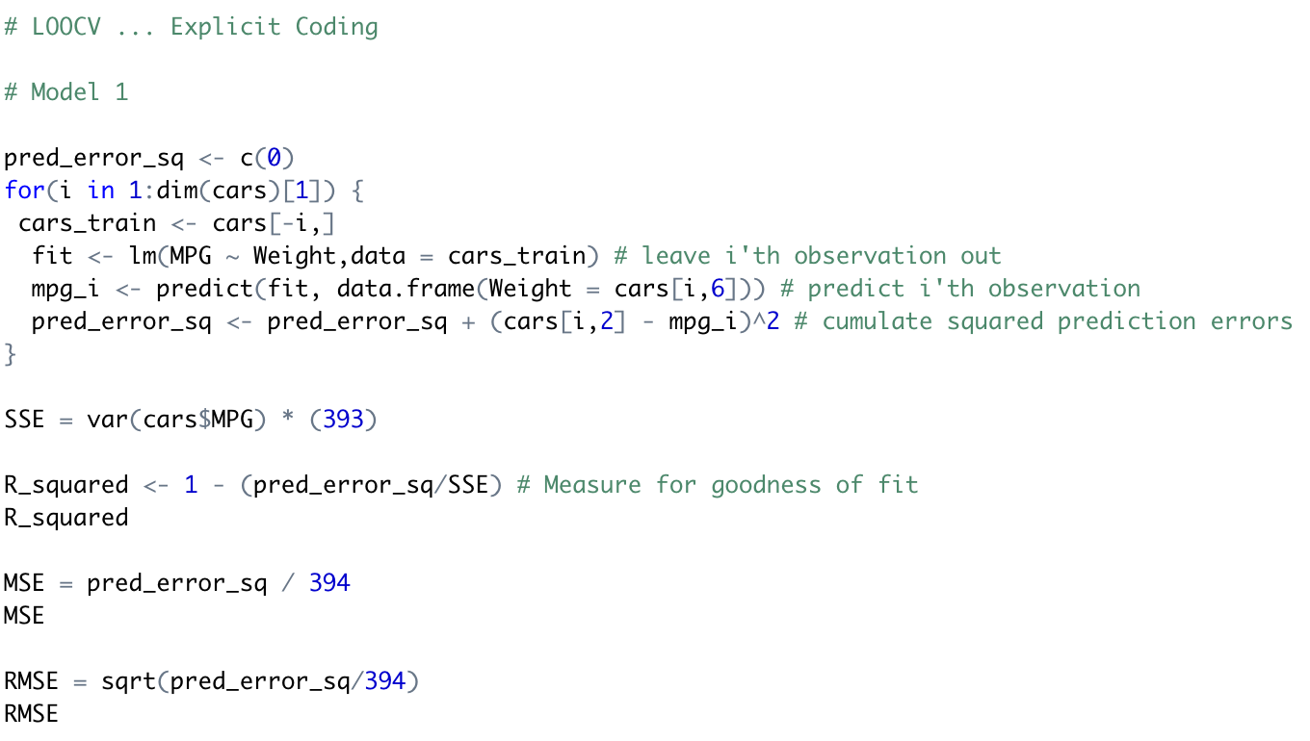
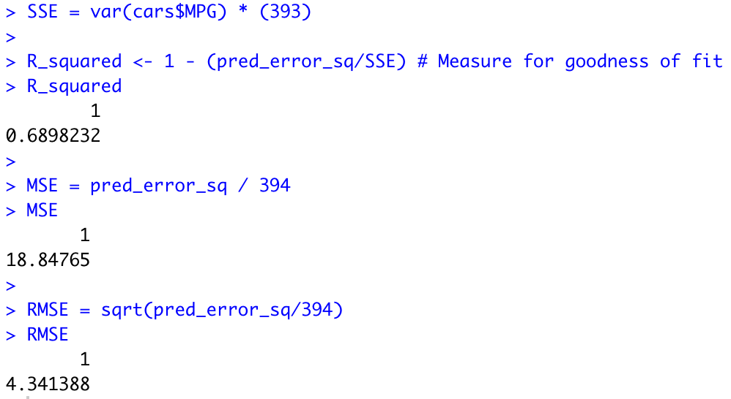

For Live Session: Question 2
2. Using the cars.csv, conduct an internal n-fold (leave one out) cross validation of the following SLR models:
Model 1: $mpg= β_{0}+β_{1}Weight+ε$

Slide 7
For Live Session: Question 2
2. Using the cars.csv, conduct an internal n-fold (leave one out) cross validation of the following SLR models:
Model 2: $mpg= β_{0}+β_{1}Weight+β_{2}{Weight}^{2}+ ε$

Slide 8
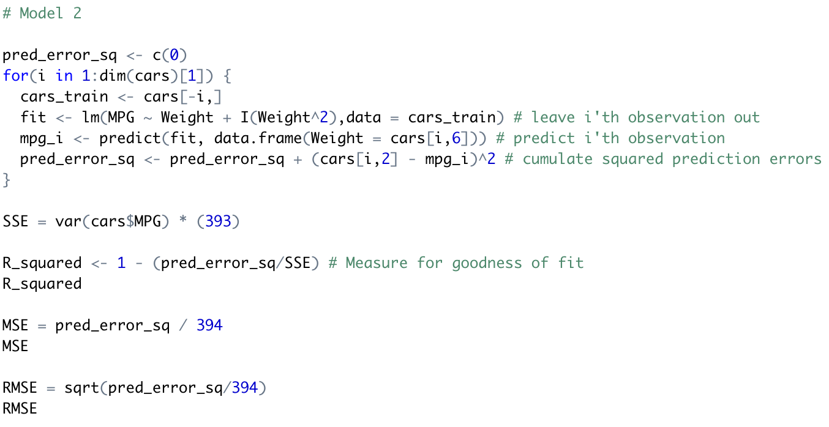
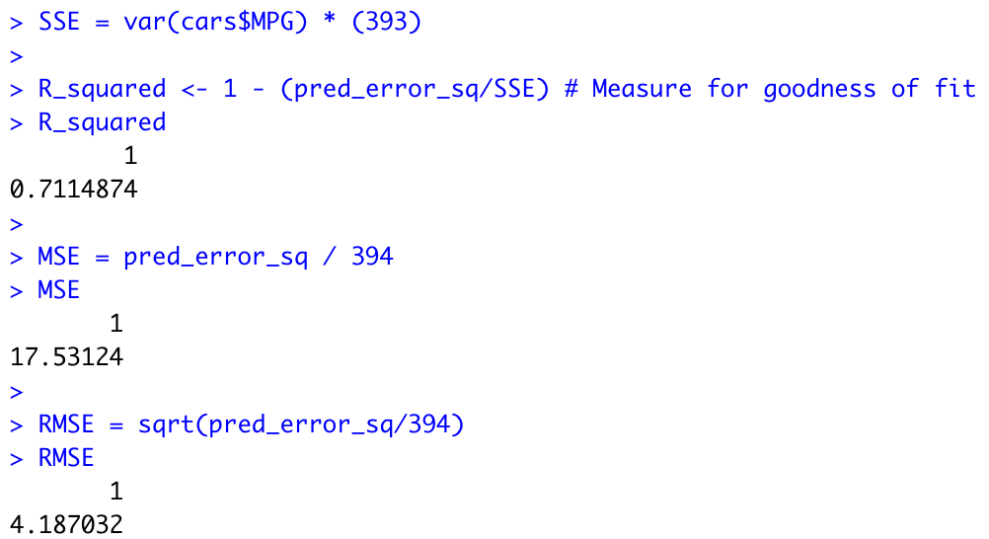
For Live Session: Question 2
2. Using the cars.csv, conduct an internal n-fold (leave one out) cross validation of the following SLR models:
Model 2: $mpg= β_{0}+β_{1}Weight+β_{2}{Weight}^{2}+ ε$

Slide 9
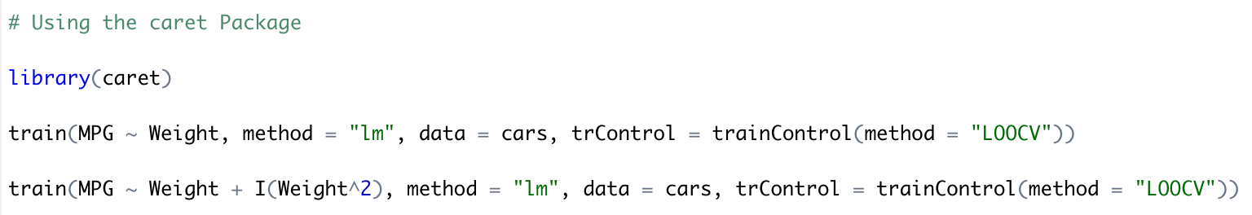
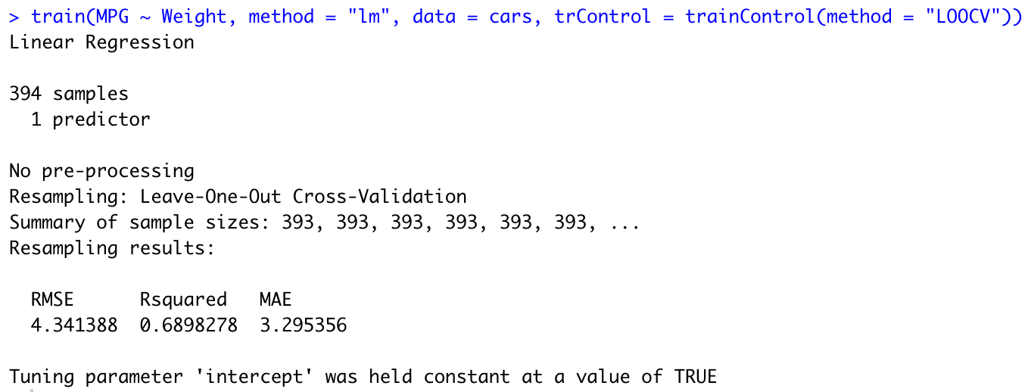
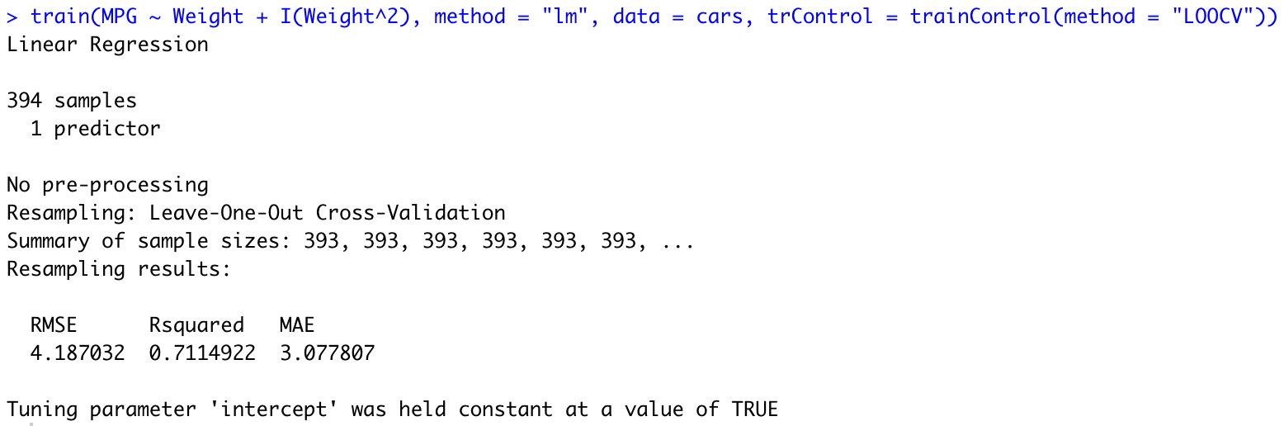
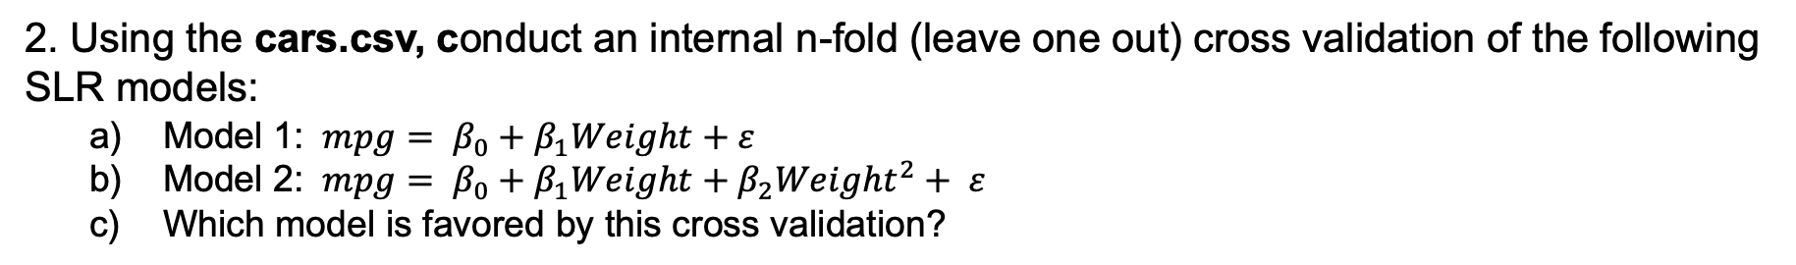
For Live Session: Question 2
2. Using the cars.csv, conduct an internal n-fold (leave one out) cross validation of the following SLR models:
Model 1: $mpg= β_{0}+β_{1}Weight+ε$
Model 2: $mpg= β_{0}+β_{1}Weight+β_{2}{Weight}^{2}+ ε$
Which model is favored by this cross validation?

Slide 10

For Live Session: Question 2
2. Using the cars.csv, conduct an internal n-fold (leave one out) cross validation of the following SLR models:
c) Which model is favored by this cross validation?
Model 1: $mpg= β_{0}+β_{1}Weight+ε$
Model 2: $mpg= β_{0}+β_{1}Weight+β_{2}{Weight}^{2}+ ε$

Slide 11
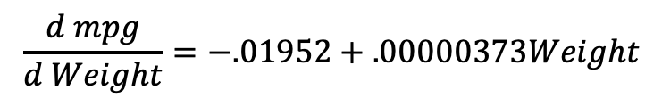
For Live Session: Question 2
2. Using the cars.csv, conduct an internal n-fold (leave one out) cross validation of the following SLR models:
d) Describe the relationship between miles per gallon and the weight of the car (if it has changed) (again making sure to quantify any uncertainty you may have.)
There is some evidence that model 2 is a better fit which suggests that the relationship between mpg and weight be be quadratic and decreasing. This is not as easy to describe as a constant slope as the rate of decrease depends on the weight of the car. However, a table with the estimated rate of decrease for some reference weights is given below. Note that the estimated model and it’s derivative (formula for the rate of change) are given below as well.
Weight | Rate of Decrease
2000 | 12.06 mpg / 1000 lbs
2500 | 10.20 mpg / 1000 lbs
3000 | 8.33 mpg / 1000 lbs
3500 | 6.47 mpg / 1000 lbs
4000 | 4.6 mpg / 1000 lbs
5000 | 0.87 mpg / 1000 lbs
$$\hat{mpg}=63.7−.01952Weight+.000001865{Weight}^{2}$$
$$\frac{d mpg}{d Weight}=−.01952+.00000373Weight$$

Slide 12
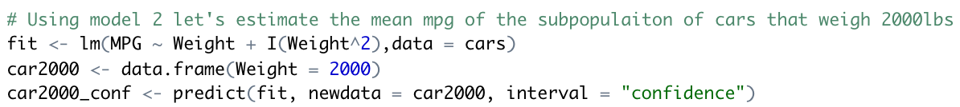
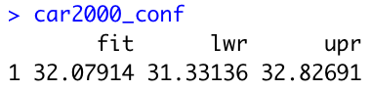
For Live Session: Question 2
2. Using the cars.csv, conduct an internal n-fold (leave one out) cross validation of the following SLR models:
e) Use the favored model to estimate the mean mpg of cars that weigh 2000 lbs.
Using the quadratic model (model 2) we are 95% confident that the mean mpg of cars that weigh 2000 lbs is between 23.455 and 40.791 mpg. Our best estimate is 32.123 mpg.

Slide 13
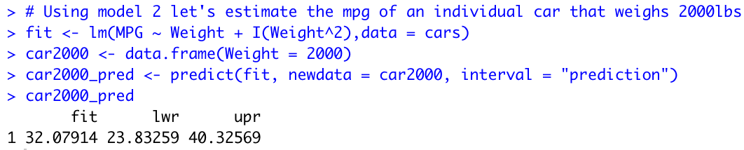
For Live Session: Question 2
2. Using the cars.csv, conduct an internal n-fold (leave one out) cross validation of the following SLR models:
f) Use the favored model to estimate the mpg of a single randomly drawn car that weighs 2000 lbs.
Using the quadratic model (model 2) we are 95% confident that a randomly selected 2000 lb car will have a mpg between 23.455 and 40.791 mpg. Our best estimate is 32.123 mpg.

Slide 14
For Live Session: Question 3
3. Using the cars.csv dataset, We would like to assess the relationship (interpret slope parameter) between mpg and horsepower. Notice that some of the horsepowers are missing.
Impute (predict and insert) the missing horsepowers by fitting a regression model.
You may use any of the variables as regressors EXCEPT for mpg (since we will later be using horsepower to predict mpg.)
Assess the relationship between the mpg and the horsepower. Make sure and include estimates of your uncertainty (ie. Confidence intervals.)
Use your model and imputed data to estimate the mean mpg for a car with 250 horsepower.

